Slide 1
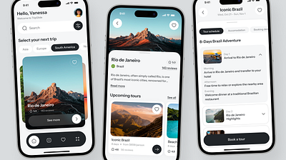
WORKSHOP
Mobile Design
with Figma
A Hands-On Workshop for Creating Modern,
User-Centric Mobile Interfaces
4-Hour Workshop
Theory + Hands-on Practice

Slide 2
WORKSHOP ROADMAP
Agenda
01
Mobile Design
Fundamentals
02
Figma for
Mobile Design
Master the mobile-first mindset, core design principles, and platform-specific guidelines for iOS and Android. Understand what makes mobile interfaces intuitive and effective.
Set up mobile frames, implement the 8pt grid system, and leverage Auto Layout for responsive components. Build a solid foundation for efficient mobile design workflows.
60 minutes
50 minutes
03
Mobile UI
Components & Patterns
04
Hands-On:
Build a Mobile Screen
Explore essential navigation patterns, particularly bottom tab bars, and common UI components. Learn design specifications and best practices for mobile interfaces.
Apply everything you've learned by designing a complete mobile profile screen from scratch. Step-by-step guidance with real-world design specifications.
40 minutes
90 minutes

Slide 3
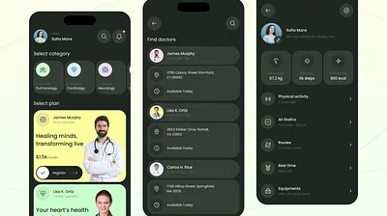
01
Mobile Design
Fundamentals
Understanding the core principles that make mobile interfaces intuitive, accessible, and delightful

Slide 4
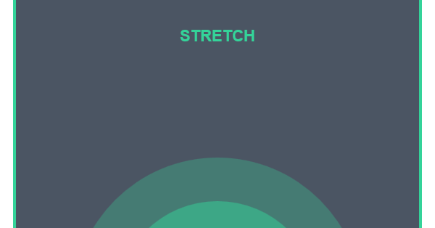
FOUNDATION
The Mobile-First Mindset
Why Mobile-First?
The Thumb Zone
Mobile usage has surpassed desktop worldwide. In 2025, over 60% of global web traffic comes from mobile devices. Designing for smaller screens first forces us to prioritize content and focus on what truly matters.
Constraints drive creativity: Limited space requires thoughtful decisions about hierarchy and content priority
Performance matters: Mobile users expect instant load times and smooth interactions
Context is key: Mobile users are often on-the-go, requiring quick, task-focused experiences
Place primary actions in the green zone for one-handed use
Key Insight
60%
70%
48dp
"15% of US adults rely solely on smartphones for internet access." — Pew Research Center
Mobile Traffic
Uninstalls Due to Poor UX
Min Touch Target

Slide 5
CORE PRINCIPLES
Mobile Design Principles & Best Practices
Clarity
Consistency
Touch Targets
Interfaces should be clean, precise, and uncluttered. Every element must have a clear purpose.
Maintain uniformity in design elements, typography, and navigation patterns across the entire app.
Ensure interactive elements are large enough for comfortable finger tapping without errors.
Clear visual hierarchy
Standard UI components
Min 48×48dp (Android)
Recognizable icons
Predictable behavior
Min 44×44pt (iOS)
Consistent spacing
Familiar patterns
Adequate spacing
Readability
Accessibility
Performance
Text must be legible at all sizes with proper contrast and spacing for comfortable reading.
Design for all users including those with disabilities. Accessibility is not optional—it's essential.
Fast, responsive interactions are crucial. Users expect immediate feedback and smooth animations.
Min 16px body text
Screen reader support
Quick load times
4.5:1 contrast ratio
Color-blind friendly
60fps animations
Dynamic type support
Voice controls
Instant feedback
Remember: These principles work together. Clarity supports accessibility, consistency improves performance perception, and proper touch targets benefit all users.

Slide 6
PLATFORM DIFFERENCES
Platform Guidelines: iOS vs Android
iOS
Android
Human Interface Guidelines
Material Design 3 / Material You
Philosophy
Philosophy
Deference, Clarity, Depth. The UI defers to content, creating a sense of depth without distracting from the user's focus.
Adaptability, Personalization, Expressiveness. Dynamic theming based on user's wallpaper creates deeply personal experiences.
Typography
Typography
SF Pro is the system font. Dynamic Type allows users to scale text. Default body size is 17pt .
Roboto and Google Sans . Clear typographic scale with support for variable fonts.
Navigation
Navigation
Bottom Navigation (56dp height) for 3-5 destinations. Navigation Rail for tablets.
Tab Bar (49pt height) at bottom for primary navigation. Navigation Bar at top for hierarchical navigation.
Buttons
Elevated buttons with shadows. FAB (Floating Action Button) for primary actions. More visual depth.
Buttons
Capsule-shaped for standout actions. Rounded rectangles for compact layouts. Minimal use of shadows.
developer.apple.com/design/human-interface-guidelines
m3.material.io
Pro Tip: Respect platform conventions but maintain brand consistency. Users expect native behaviors—don't force iOS patterns on Android users or vice versa.

Slide 7
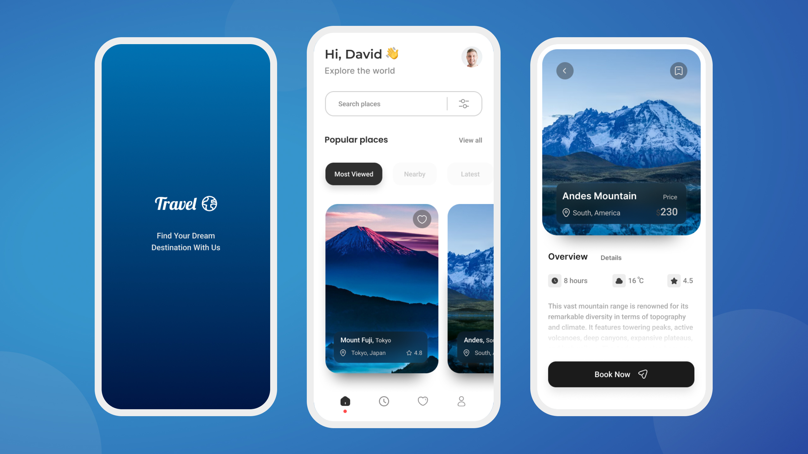
02
Figma for
Mobile Design
Mastering Figma's powerful features for efficient, scalable mobile interface creation

Slide 8
SETUP & CONFIGURATION
Setting Up Mobile Frames & Screen Sizes
Standard Frame Sizes
Quick Setup in Figma
iOS
Android
Step 1
Press F for Frame tool
Base: 375 × 667px
Base: 360 × 640px
Modern: 390 × 844px
Common: 393 × 851px
Step 2
Large: 430 × 932px
Large: 412 × 915px
Select preset from right panel
Step 3
Search "iPhone" or "Android"
Key Considerations
Start with Base Resolution
Step 4
1
Choose specific device model
Design at 1× scale. The OS automatically scales to 2×, 3× for higher density screens.
2
Safe Areas & Status Bars
Account for notches, dynamic islands, and system bars. iOS status bar: 44-59pt, Android: 24dp.
Use Vector Graphics
Screen Density Multipliers
3
1× (Base)
mdpi
Vectors scale perfectly. Export raster images at 1×, 2×, 3× for crisp display on all screens.
1.5×
hdpi
2×
xhdpi / @2x
3×
xxhdpi / @3x
4×
xxxhdpi
Pro Tip: Figma's preset frames include safe areas and device-specific dimensions. Always design within the safe area to ensure content isn't obscured by notches or system UI.

Slide 9
SPACING & RHYTHM
The 8pt Grid System & Spacing
What is the 8pt Grid?
Common Spacing Values
A spacing system where all measurements are multiples of 8 (8, 16, 24, 32, 40, 48, 56, 64...). This creates visual harmony and ensures designs scale perfectly across different screen densities.
4
Tight gaps
8
Small spacing
Why 8?
16
Standard padding
• Divides evenly into common screen sizes
24
Section gaps
• Works across all pixel densities (1×, 1.5×, 2×, 3×, 4×)
• Recommended by Apple and Google
32
Large sections
• Reduces decision fatigue—fewer choices
48
Major divisions
Applying the Grid
The Internal ≤ External Rule
Layout Spacing
Component Sizing
Space between elements should equal or exceed space within elements. This creates clear visual grouping and hierarchy.
Margins, gutters, section gaps
Buttons, inputs, cards, avatars
Padding
Typography
Internal: 8px
Internal spacing within elements
Line heights (use 4pt for finer control)
A
B
External: 16px ✓
C
D
Internal: 16px
External: 8px ✗
Remember: The 8pt grid is a guide, not a prison. Use 4pt for fine-tuning when needed, but stick to multiples of 8 for major spacing decisions.

Slide 10
ADVANCED FEATURES
Auto Layout for Mobile Components
What is Auto Layout?
Practical Example: Button
Auto Layout is Figma's powerful feature for creating responsive components that automatically adjust their size based on content. It enables dynamic, flexible designs that adapt to changes.
Get Started
Buttons that expand with longer text
Cards that grow with content
Learn More About Our Product
Lists that adapt to item count
Consistent spacing that auto-adjusts
Auto Layout Settings:
• Direction: Horizontal
• Spacing: 8px (between icon & text)
Key Properties
• Padding: 16px 24px (vertical, horizontal)
• Resizing: Hug contents
Direction
Horizontal (row) or Vertical (column) stacking
Spacing Between Items
Gap between child elements (use 8pt multiples)
How to Apply Auto Layout
Padding
1.Select frame or group of elements
Internal space around content (top, right, bottom, left)
2.Press Shift + A or click "Auto layout" in right panel
3.Configure direction, spacing, padding
Resizing
4.Set resizing behavior for each child
Hug contents, Fill container, or Fixed width/height
5.Test by editing content
Pro Tip: Combine Auto Layout with Components for maximum efficiency. Create a button component with Auto Layout, and every instance will automatically adapt to its content.

Slide 11
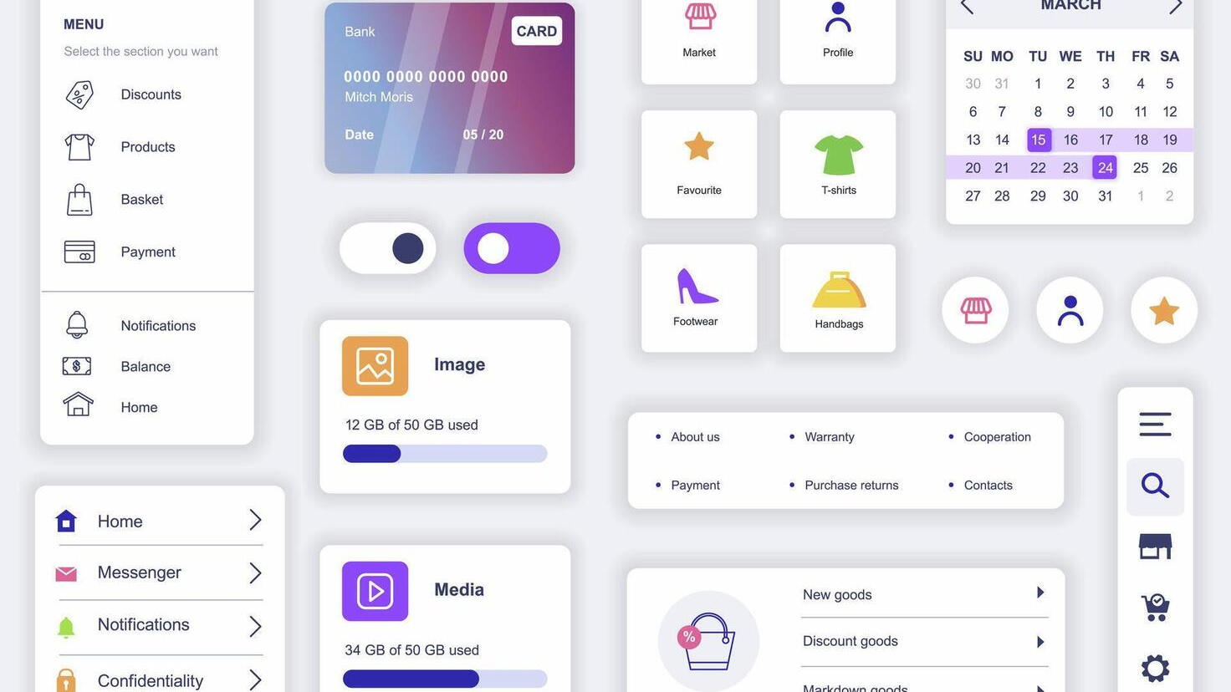
03
Mobile UI
Components & Patterns
Essential building blocks and navigation patterns for creating intuitive mobile experiences

Slide 12
NAVIGATION PATTERNS
Navigation Patterns: Bottom Tab Bar
Why Bottom Navigation Works
Real-World Examples
The bottom tab bar is mobile's most popular navigation pattern because it aligns with natural ergonomics. Users can reach primary destinations with their thumb without changing grip.
Instagram
Spotify
LinkedIn
Thumb Zone Optimized
5 tabs
3 tabs
5 tabs
Primary actions within natural thumb reach
Always Visible
Redbooth saw 65% increase in daily active users after switching from hamburger menu to bottom tab bar.
Unlike hamburger menus, navigation is persistent
One-Tap Access
Direct navigation to top-level destinations
Platform Differences
Anatomy of a Tab Bar
iOS Behavior
3-5 items
Optimal count (more = confusion)
Retains user's position in each tab when switching. Tab bar can hide on scroll.
Icon + Label
Clear, recognizable symbols
Android Behavior
Resets screen state when switching tabs. Tab bar typically stays visible.
Active State
Filled icon, accent color highlight
Height
49pt (iOS) / 56dp (Android)
Common Mistake: Don't use more than 5 items. If you need more navigation, consider a "More" tab or alternative patterns like a navigation drawer.

Slide 13
COMPONENT LIBRARY
Common Mobile UI Components
Buttons
Input Fields
Cards
Lists
Primary
Email
Item One
user@example.com
Secondary
Password
Item Two
Text Button
••••••••
Card Title
Description text here
Item Three
Height: 44-48dp
Height: 48-56dp
Corner radius: 8-12dp
Item height: 48-64dp
Min width: 88dp
Touch target: 48dp
Elevation: 2-8dp
Divider: 1dp
Avatars
Badges
Modals
FAB
SM
Modal Title
JD
AK
3
9+
Modal content goes here
Confirm
Cancel
Sizes: 24, 32, 40, 48dp
Size: 16-20dp
Corner radius: 16-28dp
Size: 56dp
Shapes: Circle, Rounded
Position: Top-right
Backdrop: 50% opacity
Position: Bottom-right
Component Tip: Always design components with states: Default, Hover, Active, Disabled, and Focus. This ensures comprehensive implementation and better user experience.

Slide 14
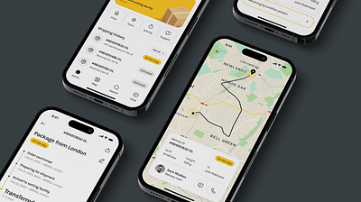
04
Hands-On
Exercise
Apply everything you've learned by building a complete mobile profile screen from scratch

Slide 15
PRACTICAL APPLICATION
Exercise: Design a Mobile Profile Screen
Design Brief
Design Specifications
Create a mobile profile screen for a social networking app. The screen should display user information, key statistics, and provide access to profile actions.
Colors
Requirements:
Typography
• Clean, modern design following platform guidelines
Heading: 24px Bold
• Use the 8pt grid system throughout
Body: 16px Regular
Caption: 12px Regular
• Implement Auto Layout for responsive components
• Ensure all touch targets meet minimum sizes
Spacing
• Apply consistent color and typography
Section gaps: 24px
Element padding: 16px
Small gaps: 8px
Step-by-Step Instructions
1
Set Up the Frame
Success Criteria
Create a mobile frame (375×667px). Add a status bar at top (44pt height).
2
Create Header Section
All spacing uses 8pt grid
Add avatar (80×80dp), user name, and bio. Use 16px padding.
Auto Layout applied to components
3
Add Stats Row
Touch targets ≥ 48dp
Create 3 stat items (Posts, Followers, Following) with Auto Layout.
Clear visual hierarchy
4
Build Action Buttons
Consistent component styles
Add "Edit Profile" and "Message" buttons. Height: 44dp, spacing: 12dp.
5
Design Content Grid
Platform-appropriate navigation
Create 3-column photo grid with 4dp gaps. Use placeholder images.
6
Add Bottom Navigation
Create tab bar with 5 items. Height: 49pt (iOS) or 56dp (Android).
Time Allocation: 90 minutes total. Spend ~15 min on each step. Don't worry about perfection—focus on applying the principles you've learned!

Slide 16
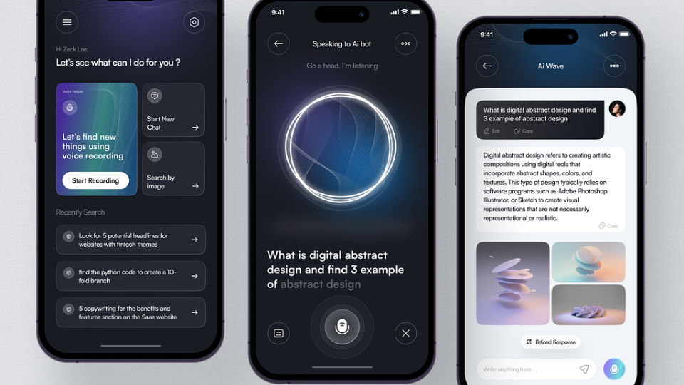
WORKSHOP COMPLETE
Key Takeaways
Mobile design is about creating intuitive, accessible experiences within constrained spaces
Mobile-First Thinking
Platform Guidelines
Start with the smallest screen. Prioritize content, embrace constraints, and design for thumbs. Remember: 60% of traffic is mobile.
Respect iOS and Android conventions. Users expect native behaviors. Follow HIG and Material Design principles while maintaining your brand identity.
The 8pt Grid
Auto Layout Power
Use multiples of 8 for all spacing. It creates visual harmony, scales perfectly, and simplifies the design-to-development workflow. Consistency is key.
Leverage Figma's Auto Layout for responsive, flexible components. Buttons that expand, cards that grow—design smarter, not harder.
Next Steps
Continue practicing by redesigning your favorite apps. Explore Figma's community resources, join design challenges, and build your own component library. Remember: great design comes from iteration and feedback.
figma.com/community
developer.apple.com/design
m3.material.io

